Slide 1
Concept Learning
By
Kamleshwar K Yadav,
Asst. Professor
Dept. of CSE, GAT

Slide 2
CONTENTS
INTRODUCTION
CONCEPT LEARNING TASK
CONCEPT LEARNING AS SEARCH
GENERAL – TO – SPECIFIC ORDERING OF
HYPOTHESES
FIND – S ALGORITHM
VERSION SPACES
REPRESENTATION
LIST – THEN – ELIMINATE ALGORITHM
CANDIDATE – ELIMINATION LEARNING ALGORITHM
REMARKS

Slide 3
INTRODUCTION
Inducing
general functions from specific
training examples is a main issue of machine learning.
Concept learning - a learning task in which a human or machine learner is trained to classify objects by being shown a set of example objects along with their class labels. The learner simplifies what has been observed by condensing it in the form of an example.
Concept learning - also known as category learning, concept attainment, and concept formation.

Slide 4
INTRODUCTION ….
Concept Learning: Acquiring the definition of a general category from given sample of positive and negative training examples of the category.
A Formal Definition for Concept Learning:
Inferring a boolean-valued function from training
examples of its input and output.
Let us try to learn the definition of a concept from examples.

Slide 5
What is a Concept? - Examples
An example for concept-learning is the learning of bird-concept from the given examples of birds (positive examples) and non-birds (negative examples).
•
The concept of a bird is the subset of all objects (i.e.,
the set of all things or all animals) that belong to the category of bird.
Things
Birds
Animals
Cars
Each
concept is a boolean-valued function defined
over this larger set. [Example: a function defined over all animals whose value is true for birds and false for every other animal]

Slide 6
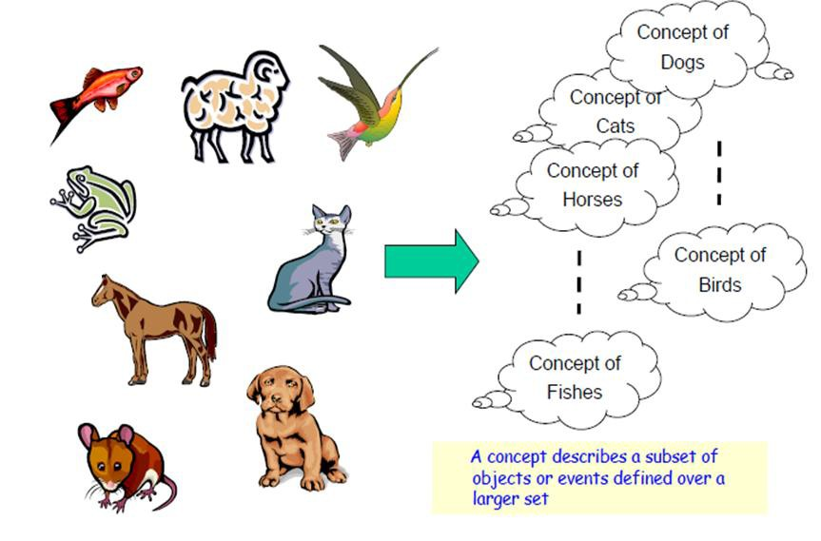
What is a Concept? – Examples …..

Slide 7


What is a Concept? – Examples …..
Concepts are categories of stimuli that
have certain features in common.
The shapes on the left are all members of a conceptual category: RECTANGLE.
Their common features are (1) 4 lines; (2) opposite lines parallel; (3) lines connected at ends; (4) lines
form 4 right angles.
But they are different colors and sizes and have different orientations is irrelevant and are not defining features of the concept

Slide 8




If a stimulus is a member of a specified
conceptual category, it is referred to as a “positive instance”.
If it is not a member, it is referred to as
“negative negative concept:
instance”. These are all
instances of the rectangle
As rectangles are defined, a stimulus is a negative instance if it lacks any one of the specified features.

Slide 9
Every concept has two components:
Attributes: These are features of a stimulus that one must look for to decide if that stimulus is a positive
instance of the concept.
A rule: This a statement that
specifies which attributes must be present or absent for a stimulus to qualify as a positive instance of the concept.
For rectangles, the attributes would be the four features and the rule would be that all the attributes must be present

Slide 10




The simplest rules refer to the presence
or absence of a single attribute. For
is
example, a “vertebrate” animal
defined as an animal with a backbone.
Which of these stimuli are
instances?
positive
_
+
This rule is called affirmation. It says
+
+
that a stimulus must possess a single specified attribute to qualify as a
positive i_{D}n_{r. M}s_{V}t_{S}a_{udh}n_{am}c_{an}e_{i}
of a concept.
10

Slide 11
The
opposite
or “complement” of
affirmation is
negation. To qualify
instance, a stimulus
as a positive
must lack a single specified attribute.
+
_
An invertebrate animal is one that lacks a backbone. These are the positive and negative instances when the negation rule is applied.

Slide 12
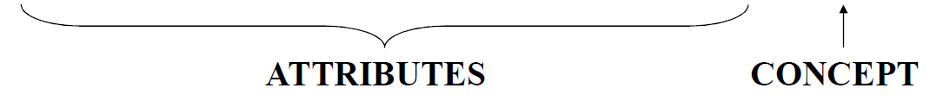
A Concept Learning Task – EnjoySport Training
Examples
Example | Sky | Temp | Humidity | Wind | Water | Forecast | EnjoyS ports
1 | Sunny | Warm | Normal | Strong | Warm | Same | Yes
2 | Sunny | Warm | High | Strong | Warm | Same | Yes
3 | Rainy | Cold | High | Strong | Warm | Change | No
4 | Sunny | Warm | High | Strong | Cool | Change | Yes
A set of example days, and each is described by six attributes.
The task is to learn to predict the value of EnjoySport for arbitrary day, based on the values of its attribute values -Target concept

Slide 13
A Concept Learning Task – Hypothesis
Representation
Goal: To infer the “best” concept-description from the set of all possible hypotheses.
Each hypothesis consists of a conjunction of constraints on the instance attributes.
Each
hypothesis will be a vector of six
constraints, specifying the values of the six attributes
(Sky, AirTemp, Humidity, Wind, Water, and
Forecast)

Slide 14
A Concept Learning Task – Hypothesis
Representation…..
Each attribute will be:
? - indicating any value is acceptable for the
attribute (don’t care)
single value – specifying a single required value
(ex. Warm) (specific)
0 - indicating no value is acceptable for the attribute (no value)
A hypothesis:
Sky AirTemp Humidity Wind Water Forecast
< Sunny, ?, ?, Strong , ? , Same >

Slide 15
A Concept Learning Task – Hypothesis Representation…..
Most General Hypothesis: Everyday is a good day for water sports <?, ?, ?, ?, ?, ?> (Positive example)
Most Specific Hypothesis: No day is a good day for water sports <0, 0, 0, 0, 0, 0> (No day is Positive example)
EnjoySport concept learning task requires learning the sets of days for which EnjoySport = yes, describing this set by a conjunction of constraints over the instance attributes.

Slide 16
EnjoySport Concept Learning Task
Given:
Instances X: Set of all Possible days, each described by the attributes
Sky (Sunny, Cloudy, and Rainy)
Temp (Warm and Cold)
Humidity (Normal and High)
Wind (Strong and Weak)
Water (Warm and Cool)
Forecast (Same and Change)
Target Concept (Function) c :
EnjoySport : X → {0,1}
Hypotheses H : Each hypothesis is described by a conjunction of
constraints on the attributes.
Training Examples D : positive and negative examples of the target function along with their target concept value c(x).
Determine : A hypothesis h in H such that h(x) = c(x) for all x in D.

Slide 17
EnjoySport Concept Learning Task…..
Members of the concept (instances for which c(x)=1) are
called positive examples.
Nonmembers of the concept (instances for which c(x)=0)
are called negative examples.
H represents the set of all possible hypotheses. H is determined by the human designer’s choice of a hypothesis representation.
The goal of concept-learning is to find a hypothesis h: X → {0, 1} such that h(x)=c(x) for all x in D.
Example of a hypothesis: <?, Cold, High, ?, ?, ?>
If the air temperature is cold and the humidity high then it is a good day for water sports.
17

Slide 18
Concept Learning As Search
Concept Learning can be viewed as the task of searching through a large space of hypotheses implicitly defined by the hypothesis representation.
The goal of this search is to find the hypothesis that
best fits the training examples.
The
hypothesis space has a general-to-specific
ordering of hypotheses, and the search can be efficiently organized by taking advantage of a naturally occurring structure over the hypothesis space.
By selecting a hypothesis representation, the designer of the learning algorithm implicitly defines the space of all hypotheses that the program can ever represent and therefore can ever learn.

Slide 19
Enjoy Sport - Hypothesis Space
Sky has 3 possible values, and other 5 attributes have 2 possible values.
There are 96 (= 3.2.2.2.2.2) distinct instances in X.
There are 5120 (=5.4.4.4.4.4) syntactically distinct hypotheses in H.
– Two more values for attributes: ? and 0
Every hypothesis containing one or more 0 symbols
represents the empty set of instances.
that is, it classifies every instance as negative.

Slide 20
Enjoy Sport - Hypothesis Space…..
There are 973 (= 1 + 4.3.3.3.3.3) semantically distinct hypotheses in H.
– Only one more value for attributes: ?, and one hypothesis representing empty set of instances.
Although EnjoySport has small, finite hypothesis space, most learning tasks have much larger (even infinite) hypothesis spaces.
– We need efficient search algorithms on the
hypothesis spaces.
20

Slide 21
Concept Learning As Search: General-to-
Specific Ordering of Hypotheses
The hypothesis space has a general-to-specific ordering of hypotheses, and the search can be efficiently organized.
Hypothesis representation
define
Hypotheses space
Best fit?
Search
Training
examples
Desired hypothesis
Dr. M V Sudhamani

Slide 22
Concept Learning As Search: General-to-
Specific Ordering of Hypotheses
Definition:
Let h_{j} h_{k}
and be boolean-valued
functions defined over X. Then
h_{j} is more-
general-than-or-equal-to
[(h_{k}(x) = 1) → (h_{j} (x)=1)]
h_{k} iff for all x in X,
Example:
h1 = <Sunny, ?, ?, Strong, ?, ?>
h2 = <Sunny, ?, ?, ?, ?, ?>
Every instance that are classified as positive by h1 will also be classified as positive by h2 in our example data set. Therefore h2 is more general than h1.
We also use the ideas of “strictly” -more-general-than,
and more-specific-than [Mitchell].

Slide 23
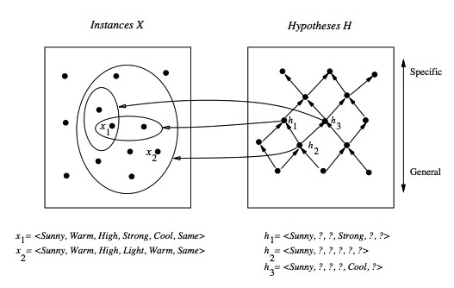
More General than Relation

Slide 24
Find –S Algorithm : Finding a Maximally
Specific Hypothesis Learning Algorithm
FIND-S Algorithm starts from the most specific hypothesis and generalize it by considering only positive examples.
FIND-S algorithm ignores negative examples.
As long as the hypotheses space contains a hypothesis that describes the true target concept, and the training data contains no errors, ignoring negative examples does not cause to any problem.
FIND-S algorithm finds the most specific hypothesis within H that is consistent with the positive training examples.
The final hypothesis will also be consistent with negative examples if the correct target concept is in H, and the training examples are correct.

Slide 25
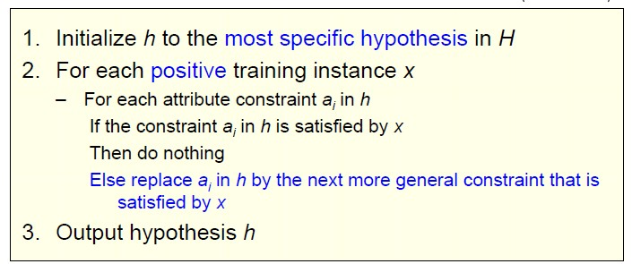
Find –S Algorithm : Finding a Maximally
Specific Hypothesis Learning Algorithm…

Slide 26
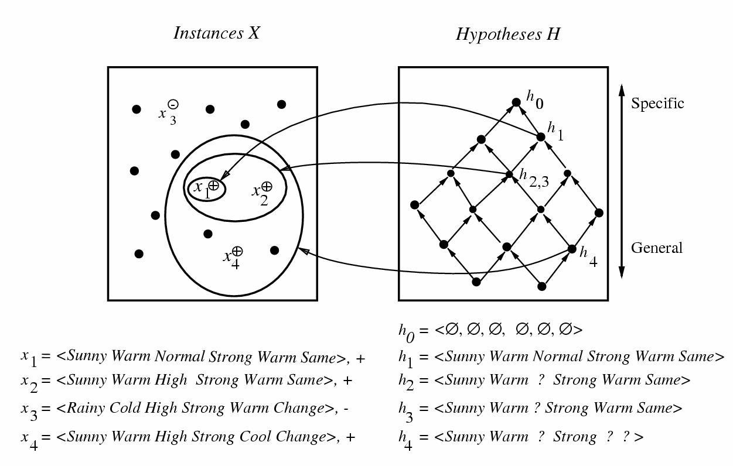

Slide 27
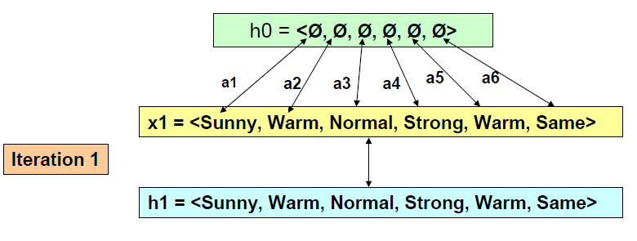
Find –S Algorithm: Example

Slide 28
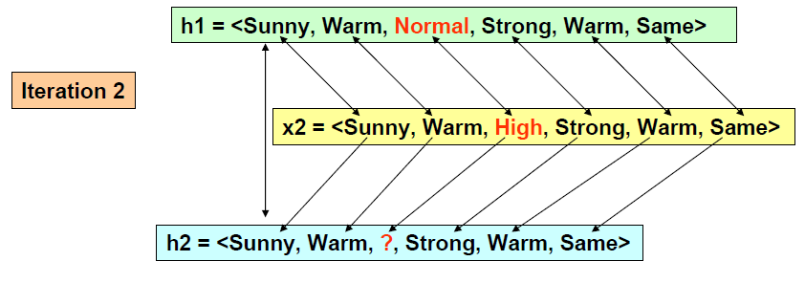
Find –S Algorithm: Example……

Slide 29
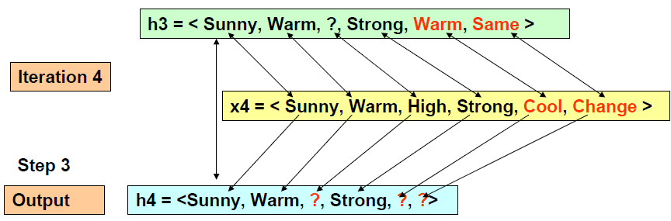
Find –S Algorithm: Example

Slide 30
Properties and Shortcomings of Find-S
Find-S is guaranteed to output the most specific hypothesis within H that is consistent with the positive training examples
The final hypothesis will also be consistent with the
negative examples
Although Find-S finds a hypothesis consistent with the training data, it does not indicate whether that is the only one available
Is it a good strategy to prefer the most specific hypothesis?
What if the training set is inconsistent (noisy)?
What
if there are several maximally specific
consistent hypotheses? Find-S cannot backtrack!
₇N_{/19/}e₂₀₁g₈ ative example are_{Dr.}n_{M}o_{V S}t_{udh}c_{am}o_{an}n_{i} sidered
30

Slide 31
Version Spaces and the Candidate
Elimination Algorithm
FIND-S
outputs a hypothesis from H, that is
consistent with the training examples, this is just one of many hypotheses from H that might fit the training data well.
The key idea in the Candidate-Elimination algorithm is to output a description of the set of all hypotheses consistent with the training examples.
Candidate-Elimination algorithm computes the description of this set without explicitly enumerating all of its members.
This is accomplished by using the more-general- than partial ordering and maintaining a compact representation of the set of consistent hypotheses.

Slide 32
Version Spaces
The Candidate-Elimination algorithm represents the set of all hypotheses consistent with the observed training examples.
This subset of all hypotheses is called the version space with respect to the hypothesis space H and the training examples D, because it contains all plausible versions of the target concept.

Slide 33
Version Spaces …
Definition: A hypothesis h is consistent with a set of training examples D iff h(x) = c(x) for each example < x, c(x) > in D.
Definition: The version space, denoted VS_{H,D} with respect to hypothesis space H and training examples D, is the subset of hypotheses from H consistent with the training examples in D.
VS_{H,D} ≡ {h ∈ H | Consistent(h, D)}
NB: While a | Version | Space can be exhaustively
enumerated, | a more | compact representation is
preferred.

Slide 34
The Idea
An explicit list of hypotheses : List-Then- Eliminate Algorithm
A compact representation of hypotheses which exploits the more_general_than partial ordering: Candidate-Elimination Algorithm

Slide 35
List-Then-Eliminate algorithm
Version space as list of hypotheses
1. VersionSpace ← a list containing every
hypothesis in H
For each training example, ⟨x, c(x)⟩
Remove from VersionSpace any hypothesis h
for which h(x) ≠ c(x)
Output the list of hypotheses in VersionSpace

Slide 36
List-Then-Eliminate algorithm…
Problems
The hypothesis space must be finite
Enumeration of all the hypothesis, rather inefficient

Slide 37
A Compact Representation for Version Space
Instead of enumerating all the hypotheses consistent with a training set, we can represent its most specific and most general boundaries. The hypotheses included in-between these two boundaries can be generated as needed.
Definition: The general boundary G, with respect to hypothesis space H and training data D, is the set of maximally general members of H consistent with D.
Definition: The specific boundary S, with respect to hypothesis space H and training data D, is the set of minimally general (i.e., maximally specific) members of H consistent with D.

Slide 38
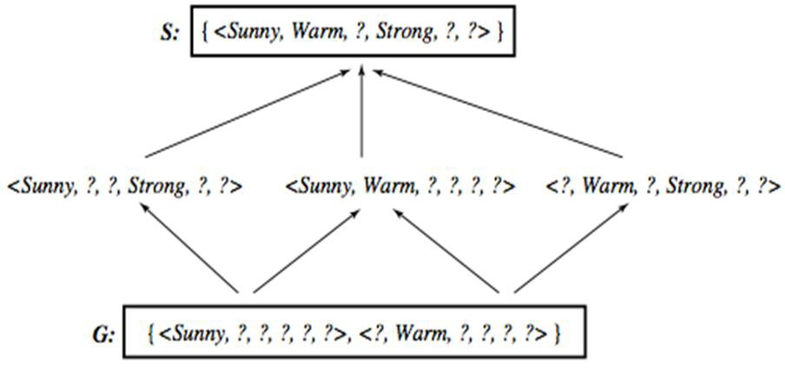
Representation for Version Space with General
and Specific Boundary Sets
No7t/1e9:/2T01h8e output of Find-S is just ⟨SDur.nMnVyS,udWhamaarnmi , ?, Strong, ?, ?⟩
38

Slide 39
Candidate Elimination Algorithm
S ← minimally general hypotheses in H, G ← maximally general hypotheses in H Initially any hypothesis is still possible
S₀ = ⟨∅, ∅, ∅, ∅, ∅, ∅⟩ G₀ = ⟨?, ?, ?, ?, ?, ?⟩
Initialize G to the set of maximally general hypotheses in H
Initialize S to the set of maximally specific hypotheses in H

Slide 40
Candidate Elimination Algorithm
For each training example d, do
If d is a positive example
Remove from G any hypothesis inconsistent with d
For each hypothesis s in S that is not consistent with d
Remove s from S
Add to S all minimal generalizations h of s such that
o h is consistent with d, and some member of G is
more general than h
Remove from S any hypothesis that is more general
than another hypothesis in S

Slide 41
Candidate Elimination Algorithm …
If d is a negative example
Remove from S any hypothesis inconsistent with d
For each hypothesis g in G that is not consistent with d
Remove g from G
Add to G all minimal specializations h of g such that
o h is consistent with d, and some member of S is more specific than h
– Remove from G any hypothesis that is less general
than another hypothesis in G
41

Slide 42
Example: Initially
S₀ :
⟨∅, ∅, ∅, ∅, ∅. ∅⟩
⟨?, ?, ?, ?, ?, ?⟩
G₀
7/19/2018
Dr. M V Sudhamani

Slide 43
Example:
after seeing ⟨Sunny, Warm, Normal, Strong, Warm, Same ⟩ +
S₀:
⟨∅, ∅, ∅, ∅, ∅. ∅⟩
S₁:
⟨Sunny, Warm, Normal, Strong, Warm, Same⟩
⟨?, ?, ?, ?, ?, ?⟩
G , G₁
0
7/19/2018
Dr. M V Sudhamani

Slide 44
Example:
after seeing ⟨Sunny, Warm, High, Strong, Warm, Same⟩ +
S₁:
⟨Sunny, Warm, Normal, Strong, Warm, Same⟩
S₂:
⟨Sunny, Warm, ?, Strong, Warm, Same⟩
G₁, G₂
⟨?, ?, ?, ?, ?, ?⟩
7/19/2018
Dr. M V Sudhamani

Slide 45
Example:
after seeing ⟨Rainy, Cold, High, Strong, Warm, Change ⟩ −
S_{2,} S₃:
⟨Sunny, Warm, ?, Strong, Warm, Same⟩
G₃:
⟨Sunny, ?, ?, ?, ?, ?⟩ ⟨?, Warm, ?, ?, ?, ?⟩ ⟨?, ?, ?, ?, ?, Same⟩
G₂:
⟨ ?, ?, ?, ?, ?, ?, ?⟩
7/19/2018
Dr. M V Sudhamani

Slide 46
Example:
after seeing ⟨Sunny, Warm, High, Strong, Cool Change ⟩ +
S₃
⟨Sunny, Warm, ?, Strong, Warm, Same⟩
⟨Sunny, Warm, ?, Strong, ?, ?⟩
S₄
⟨Sunny, ?, ?, ?, ?, ?⟩ ⟨?, Warm, ?, ?, ?, ?⟩
G₄:
⟨Sunny, ?, ?, ?, ?, ?⟩ ⟨?, Warm, ?, ?, ?, ?⟩ ⟨?, ?, ?, ?, ?, Same⟩
G₃:
7/19/2018
Dr. M V Sudhamani

Slide 47
Example:
Given that there are six attributes that could be specified to specialize G2, why are there only three new hypotheses in G3?
For example, the hypothesis h = <?, ?, Normal, ?, ?, ?> is a minimal specialization of G2 that correctly labels the new example as a negative example, but it is not included in G3.
The reason for excluding this hypothesis is that it is
inconsistent with S2.
The algorithm determines this simply by noting that h is not more general than the current specific boundary, S2.
7/19/2018
Dr. M V Sudhamani

Slide 48
Example:
The
S boundary of the
version
space forms a
summary of the previously encountered positive examples that can be used to determine whether any given hypothesis is consistent with these examples.
The G boundary summarizes the information from previously encountered negative examples. Any hypothesis more specific than G is assured to be consistent with past negative examples.
7/19/2018
Dr. M V Sudhamani

Slide 49
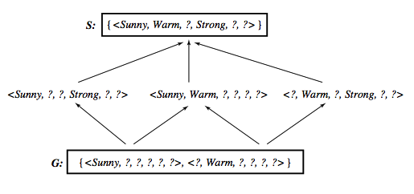
Learned Version Space

Slide 50
Observations
The learned Version Space correctly describes the target concept, provided:
There are no errors in the training examples
There is some hypothesis that correctly describes the target concept
If S and G converge to a single hypothesis then
concept is exactly learned
In case of errors in the training, useful hypothesis are discarded, no recovery possible
An empty version space means no hypothesis in H is consistent with training examples
50

Slide 51
Ordering on Training Examples
The learned version space does not change with
different orderings of training examples
Efficiency does
Optimal strategy (if you are allowed to choose)
Generate instances that satisfy half the hypotheses in the current version space. For example:
⟨Sunny, Warm, Normal, Light, Warm, Same⟩
satisfies 3/6 hypothesis
Ideally the VS can be reduced by half at each experiment
Correct target found in ⎡log₂|VS|⎤ experiments

Slide 52
Use of Partially Learned Concepts
Classified as positive by all hypothesis, since satisfies any hypothesis in S

Slide 53
Classifying new examples
Classified as negative by all hypothesis, since does not satisfy any hypothesis in G

Slide 54
Classifying new examples…..
Uncertain classification: half hypothesis are consistent, half are not consistent

Slide 55
Classifying new examples…..
⟨Sunny, Cold, Normal, Strong, Warm, Same⟩
4 hypothesis not satisfied, 2 satisfied Probably a negative instance.

Slide 56
Comparison
Algorithm | Order | Strategy | N/P
FIND-S | Specific-to- general | Top-down | Positive
LIST-THEN- ELIMINATE | General-to- Specific | Bottom-up | Negative
CANDIDATE- ELIMINATION | Bi-directional | Bi-directional | Both

Slide 57
Concept Learning - Summary
Concept learning can be seen as a problem of searching
The general-to-specific partial ordering of hypotheses provides a useful structure for organizing the search through the hypothesis space.
The FIND-S algorithm utilizes this general-to-specific ordering, performing a specific-to-general search through the hypothesis space.
The CANDIDATE-ELIMINATION algorithm utilizes this general-to- specific ordering to compute the version space by incrementally computing the sets of maximally specific (S) and maximally general (G) hypotheses.
The CANDIDATE-ELIMINATION algorithm is not robust to noisy data or to situations in which the unknown target concept is not expressible in the provided hypothesis space.

Slide 58


Slide 59



Thank you All

